Slide 1





Project presentation Ghent:
Market engagement and innovation procurement
FIRE SERVICES DEVELOP INNOVATIVE PROCUREMENT
Fired-uP Final Conference
London, July 8, 2015
Morning session

Slide 2

Problem statement
Innovative multifunctional second line vehicle
with low environmental impact
Flooding material
Diving team
Chemical gas suits
Signalization
Rescue material
Fuel transport
…
FIRE SERVICES DEVELOP INNOVATIVE PROCUREMENT

Slide 3
Methodical approach
City of Ghent working together with longtime partner Ghent Fire Brigade
Needs assessment
Market consultation
Choice of tendering procedure
Writing tender
Awarding of contract
FIRE SERVICES DEVELOP INNOVATIVE PROCUREMENT

Slide 4
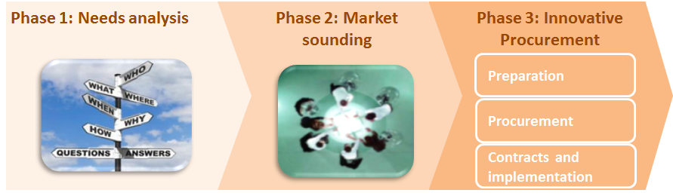
Methodical approach
FIRE SERVICES DEVELOP INNOVATIVE PROCUREMENT

Slide 5
Needs assessment
WHAT?
moderated workshop to brainstorm on use-cases with end-users
WHO?
- who will use the 2nd line firefighting vehicles: courier, driver
- who will be impacted indirectly: department management, policymaker
SUBJECT OF DISCUSSION?
A prioritized list of detailed use-cases related to 2nd line firefighting vehicles, clearly expressing today’s unanswered needs and envisaged added value, from the perspective of the Fire Brigades:
  Chassis WOW:
    Easy to use with intuitive control system
    sustainability
  Built-up body WOW:
    Polyvalence – mixing loads
    Easy to operate (crane, hook-lift, or other alternative)
  Software WOW:
    Route optimization and automated order picking lists
FIRE SERVICES DEVELOP INNOVATIVE PROCUREMENT

Slide 6
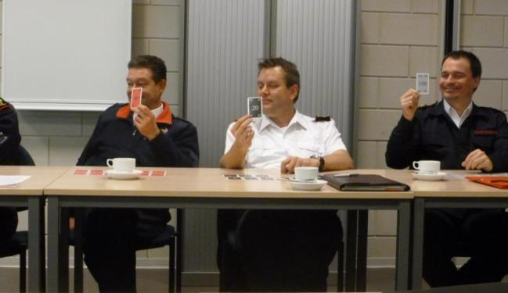
Needs assessment
FIRE SERVICES DEVELOP INNOVATIVE PROCUREMENT
Notes:
Several sessions with key users who are directly using the vehicle (courier, driver,…) or who are indirectly impacted by it. As such the high-level needs for new second-line vehicles were listed into a wishlist of detailed key user requirements.

Slide 7
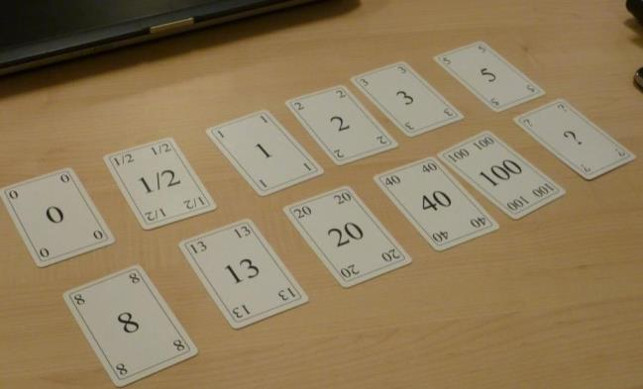
Needs assessment
Scoring the value of use cases from a user’s perspective:
0 Not usable, no additional value for the user
2-3 “nice to have”, if we have the time and
resources
13 We should definitely do this. “must have”
20+ “wow!” “Homerun!” ?
No user experience in this topic
FIRE SERVICES DEVELOP INNOVATIVE PROCUREMENT

Slide 8
Needs assessment
Use-case 1: As a courier, I can operate the vehicle in an intuitive way (e.g. traditional) so that my life is simple
Score of the innovation potential: 40
With a score of 40, an intuitive way of operating the vehicle is seen as high priority. Not excluded is the traditional way of operating a vehicle, but also other new and preferably even more intuitive ways are seen as possibilities.
Use-case 8: As a driver, I can perform all my tasks with only one type of vehicle so that I don’t have to use another vehicle every time.
Score of the innovation potential: 40
No remarks
Use-case 21: As a policymaker, I can lower consumption during driving and interventions so that my policy is consistent with climate goals.
Score of the innovation potential: 40
No remarks
FIRE SERVICES DEVELOP INNOVATIVE PROCUREMENT

Slide 9
Market Consultation/Sounding
What?
2 days of plenary meetings and group work sessions
  Day 1: session on a light vehicle (3,5T-7,2T)
  Day 2: session on a heavy vehicle (2 axle, 16-19T)
WHO? (invited by PIN)
  Buyers
  Suppliers: chassis manufacturers, body builders, crane manufacturers, etc.
Objective
To formulate a detailed answer on following key questions:
  Which technological solutions are already feasible today?
  Where are innovative breakthroughs needed
  What are the priorities of an innovative solution, that should realize both the innovation potential for the end-users as reduce the (technological) risks?
FIRE SERVICES DEVELOP INNOVATIVE PROCUREMENT

Slide 10
Market Consultation/Sounding
How?
Planning poker method from consultant ADDESTINO: for the assessment of the feasibility and severity of sources of risk
What was discussed?
CHASSIS | BUILD-UP | Software
User friendly easily manageable and manoeuvrable Innovative motor and gear systems (F.ex. automatic stop & go system, ways to control power and reduce consumption during interventions, kinetic energy recovery) Ideas to reduce the environmental impact of the vehicle were welcomed: low rolling resistance tyres, advanced materials, sustainability labels. | transport mixed loads, perform different tasks, have a fast deployable system, user-friendly loading - unloading cycle with no additional material or personnel. Innovation possibilities in used material were addressed. The points of focus were on strength and robustness, weight and reusability. | Route optimisation Order picking

Slide 11
Market Consultation/Sounding
Result?
Report providing insights on current market state-of-the-art
Both light and heavy vehicle makes sense
some technological solutions exist close enough to the market to fulfull primary user requirements
set of insights, conclusions and functional specifications that serve as a basis for the creation of the tender documents
In the tender documents we included what came out of the consultation
FIRE SERVICES DEVELOP INNOVATIVE PROCUREMENT

Slide 12
Procurement strategy
Negotiated procedure with prior notice
Justification for choice of method: nature of the contract is notably a complex supply that includes innovation, pricing structures are difficult to foresee
2-step procedure
  Step 1: selection of economic operators
  Step 2: awarding phase of the contract
FIRE SERVICES DEVELOP INNOVATIVE PROCUREMENT

Slide 13
The tender award criteria
Price (maximum budget) | 5 points
Exploitation in function of cost | 10 points
Innovation in function of cost | 10 points
Quality from the viewpoint of innovation | 75 points
Subcriterium technical quality vehicle | 15
Subcriterium technical quality build-up | 20
Subcriterium safety | 10
Subcriterium comfort | 10
Subcriterium environmental impact and sustainability | 10
Subcriterium quality of exploitation | 10
FIRE SERVICES DEVELOP INNOVATIVE PROCUREMENT

Slide 14
Innovation in the tender
the tenderer needed to provide additional information on what was innovative about his offer in comparison to a classic logistic fire service vehicle, and what the exact cost of this innovative offer was
Innovative was being identified as the implementation of a new or significant improved product, process or method. The solution could consist of an existing technology or a process that had already been used elsewhere but implemented in the fire service sector.
The final comparison of the innovation was in terms of the price .
The offer with the highest innovation factor and innovation value got the highest score for this component.
FIRE SERVICES DEVELOP INNOVATIVE PROCUREMENT

Slide 15
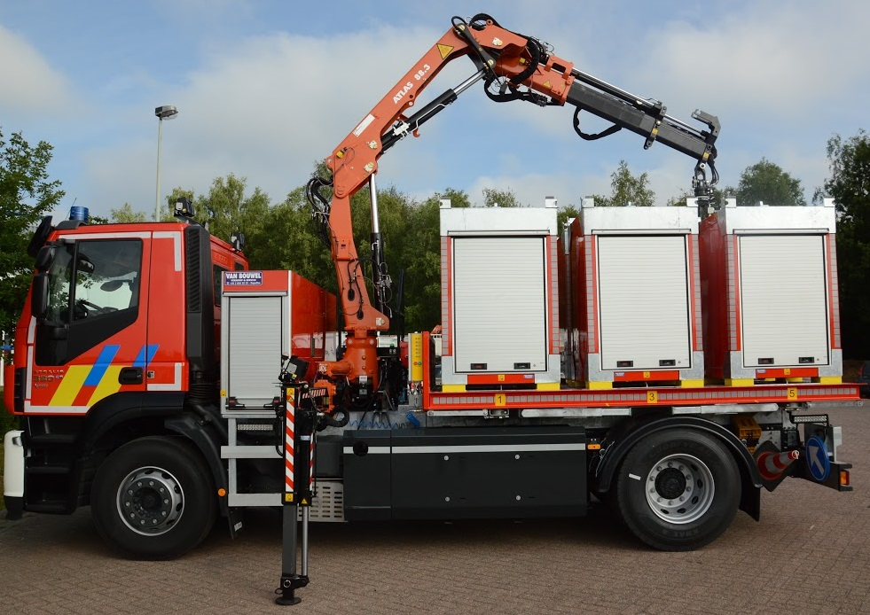
Result
After BAFO: supplier Van Bouwel was awarded the contract
CNG-powered IVECO truck with an innovative crane and modular containers
FIRE SERVICES DEVELOP INNOVATIVE PROCUREMENT

Slide 16
Contact
www.fired-up.eu
  City of Ghent, Services and Logistics:
  Botermarkt 1,
  9000 Ghent, Belgium
  0032 9 266 53 00
  lies.helsloot@stad.gent
  Johan.hoste@stad.gent
FIRE SERVICES DEVELOP INNOVATIVE PROCUREMENT

