Slide 1





Project presentation Ghent:
Multifunctional second line vehicle
FIRE SERVICES DEVELOP INNOVATIVE PROCUREMENT
Fired-uP Final Conference
London, July 8, 2015

Slide 2
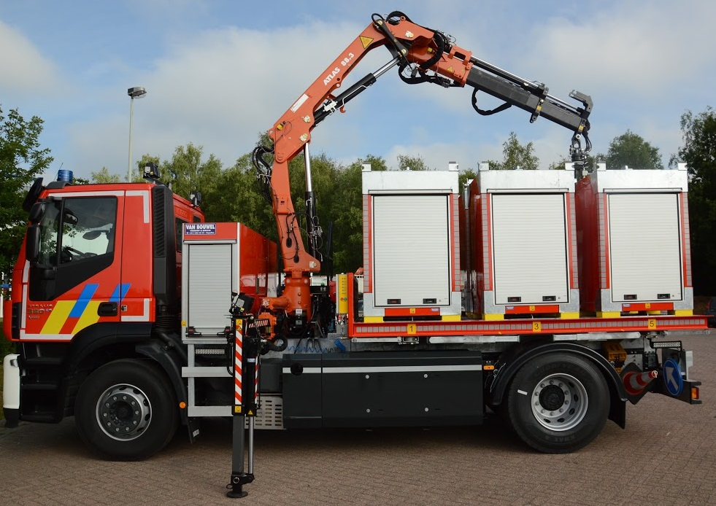
Result
After BAFO: supplier Van Bouwel was awarded the contract
CNG-powered IVECO truck with an innovative crane and modular containers
FIRE SERVICES DEVELOP INNOVATIVE PROCUREMENT

Slide 3
The Crane
Electric powered, hydraulic crane ATLAS
Company’s own embedded software to drive crane
Innovative sensors
Ecological advantages:
  Uses 70% less energy (electric engine)
  no sound during operations, only minor buzzing
  No Particulate Matters nor CO²
  No heat generation in the hydraulic oil: limited oil use
  batteries charged whilst driving or using shore power
FIRE SERVICES DEVELOP INNOVATIVE PROCUREMENT

Slide 4
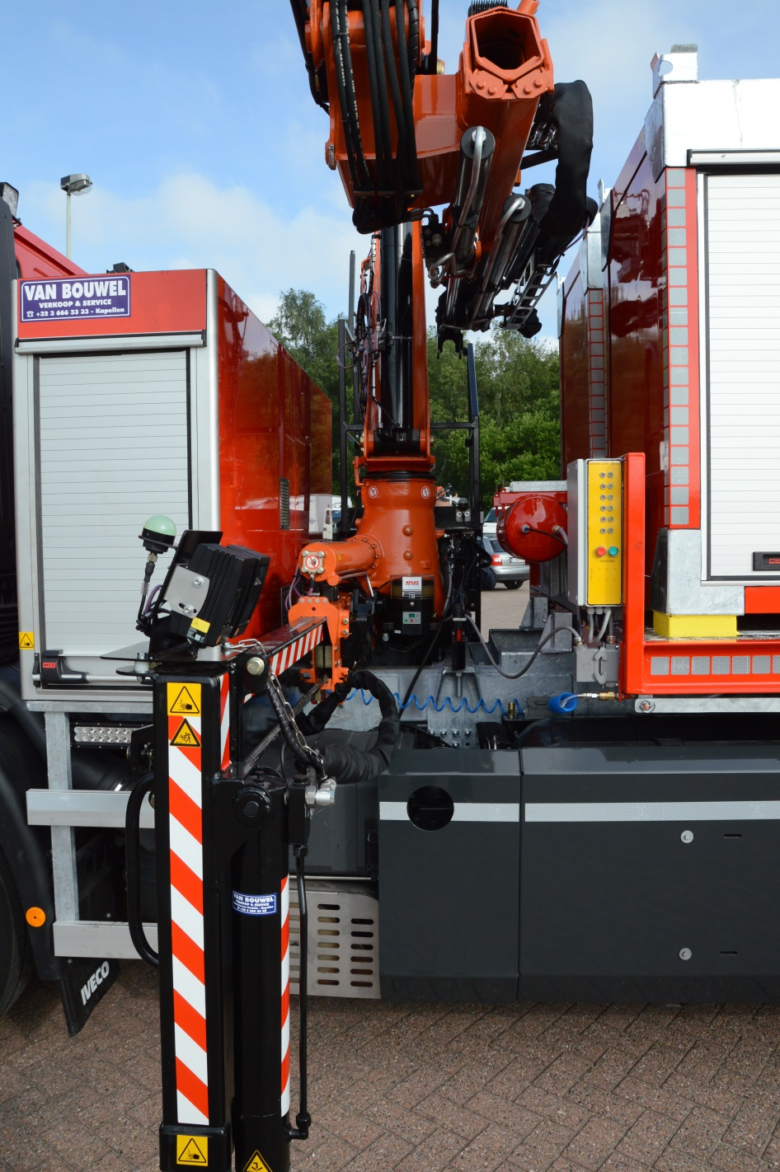
FIRE SERVICES DEVELOP INNOVATIVE PROCUREMENT

Slide 5
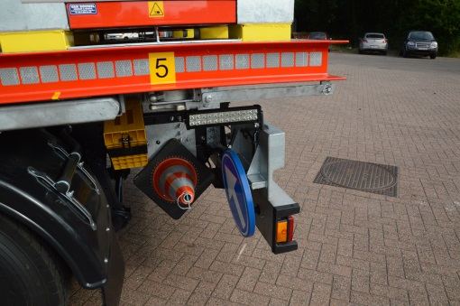
Mobile 3D smart sensor
Smart detectors in safety cone for positioning containers
FIRE SERVICES DEVELOP INNOVATIVE PROCUREMENT

Slide 6
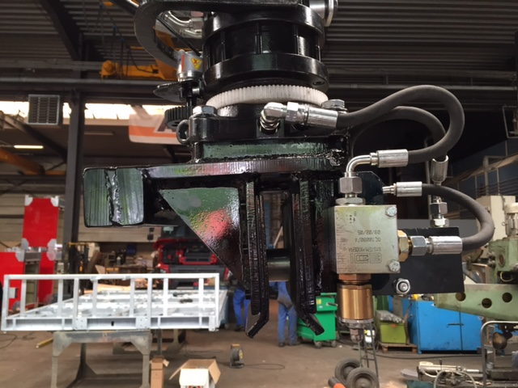
Rotatorhead with cushioning
Contraload for selfleveling
Locking axe
containerunits
Safety pin voor lock-unlock
FIRE SERVICES DEVELOP INNOVATIVE PROCUREMENT

Slide 7
The modular containers
Multifunctional
Stackable
Design fit to the need (for exemple oxygen bottles)
Glas fiber reinforced polyester
  Maintenance-free
  Impact-resistant and very strong
  Light weight, which contributes to reduced fuel consumption
  Insulating with double wall
  Flexible
  Reusable and recyclable
  Long life and acid-resistant
  Waterproof, rust and rot-resistant
FIRE SERVICES DEVELOP INNOVATIVE PROCUREMENT

Slide 9
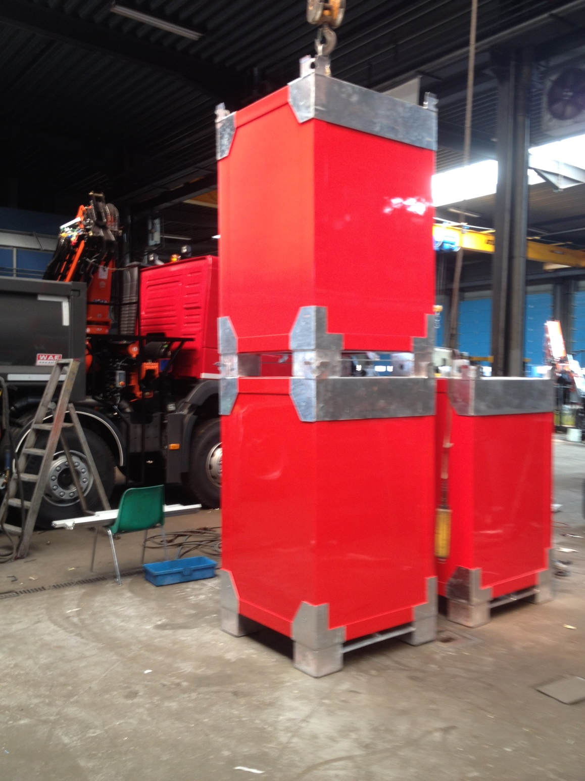
STACKABLE UNITS

Slide 10
The chassis and engine
IVECO Stralis 19ton truck with short cabin.
Creation started from a diesel engine from which only the cylinderhead (“culasse”) had been adjusted
Advantages of CNG
  to 95% less particulate matter than diesel
  Up to 12% less CO₂ (carbon dioxide) emissions than diesel
  The fuel is cheaper than diesel
  CNG emits no benzene or carcinogen no soot
  Quieter than a diesel engine
FIRE SERVICES DEVELOP INNOVATIVE PROCUREMENT

Slide 11
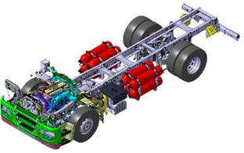
The chassis and engine
FIRE SERVICES DEVELOP INNOVATIVE PROCUREMENT

Slide 12
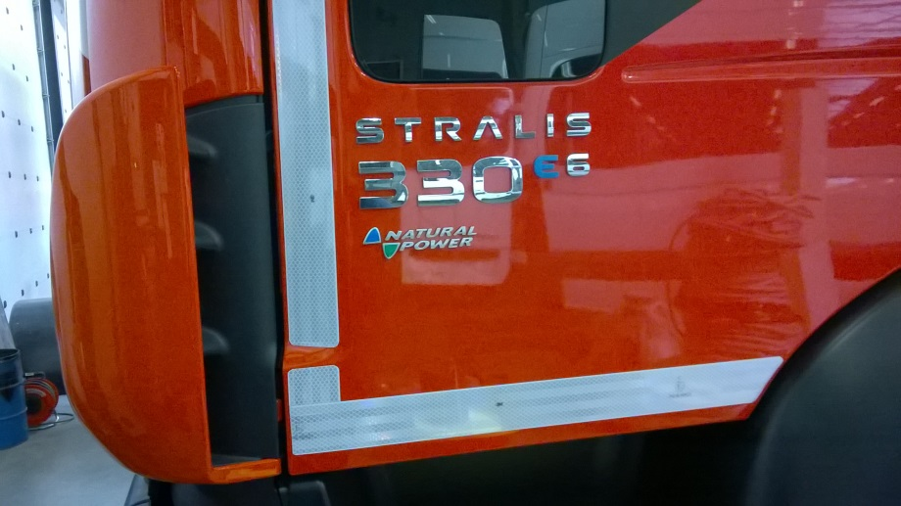
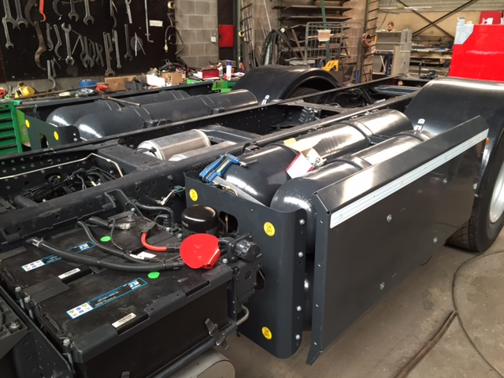
The chassis and engine
FIRE SERVICES DEVELOP INNOVATIVE PROCUREMENT

Slide 13
Contact
www.fired-up.eu
  City of Ghent, Services and Logistics:
  Botermarkt 1,
  9000 Ghent, Belgium
  0032 9 266 53 00
  lies.helsloot@stad.gent
  Johan.hoste@stad.gent
FIRE SERVICES DEVELOP INNOVATIVE PROCUREMENT

