Slide 1

CAR2GO
The future of urban mobility
Supporting WESTTRANS
WESTTRANS July 25th 2013
Trevor Storey Business Development car2go UK
Stephanie Becker Business Development car2go UK & Moovel
Thomas Beermann Chief Operating Officer car2go Europe

Slide 2

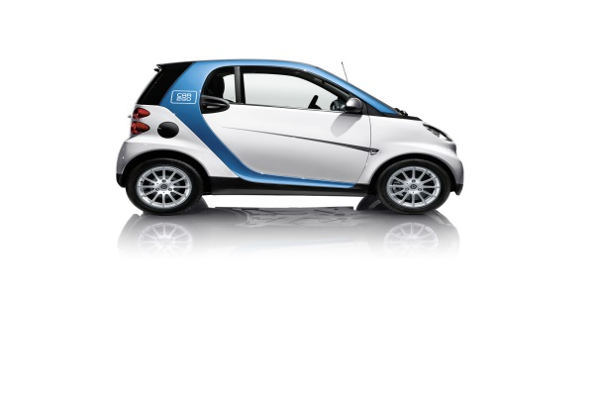





Who are car2go
J.V .with
Subsidiary
of the Daimler AG
car2go GmbH
Mercedes-Benz GmbH
Continental level
car2go N.A.
car2go Europe GmbH
National level
car2go N.A., LLC.
car2go Deutschland GmbH
car2go Canada Ltd
car2go Österreich GmbH
car2go car2go UK Ltd.
(Launched Dec 2012)

Slide 3
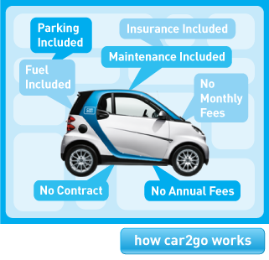
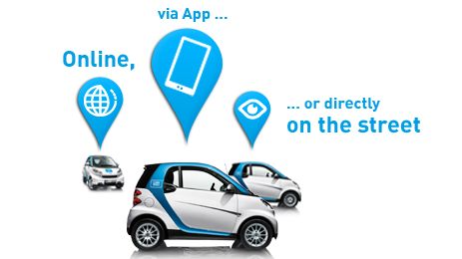
What is a car2go
car2go is an innovative urban mobility concept that uses cutting edge tech that pairs drivers with the eco-friendly car2go vehicles all over the borough and City
park anywhere within the home area
no fixed rental stations
one-way (A → B)
pay-by-the-minute, only £0,35 P.M./£14.90 P.H./£59.00 P.D.
incl. everything (fuel, parking, insurance, road tax)
no annual membership fee
available on-demand
24/7
Transparent pricing structure.
GO!
Find a car. Get in and
We’ll take care of the rest.

Slide 4
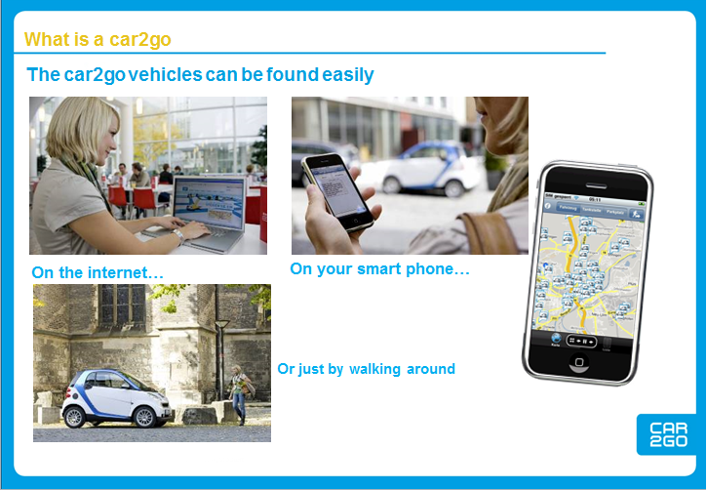

Slide 5
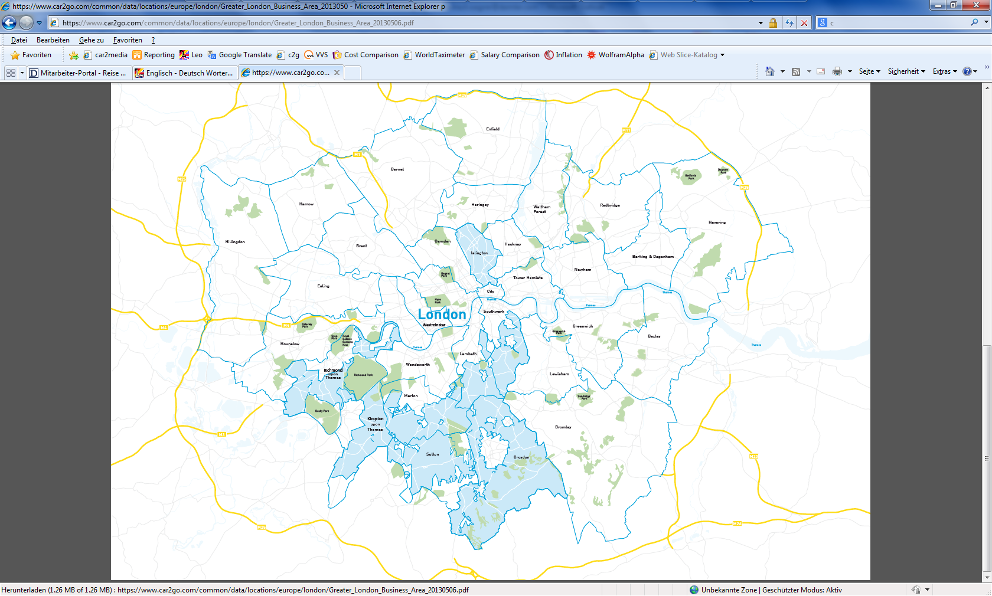


CAR2GO LONDON: OPERATING AREA

Slide 6
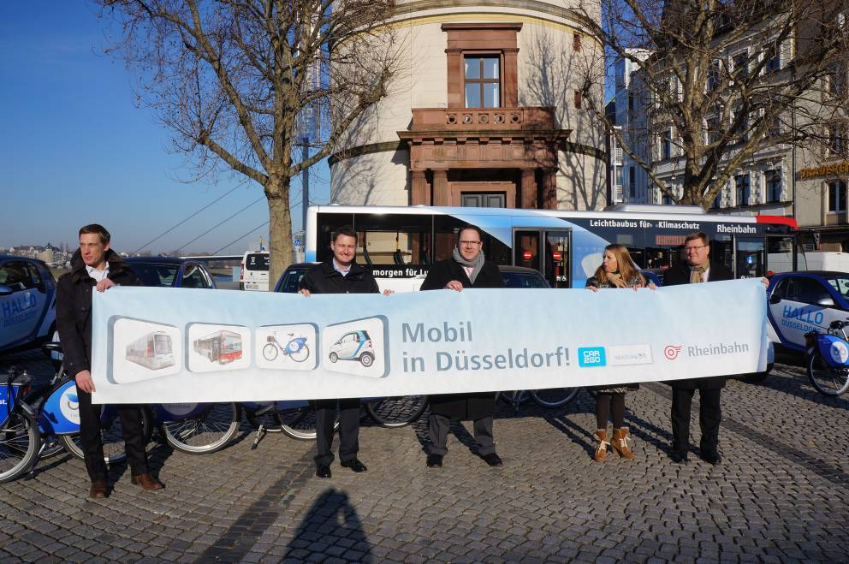



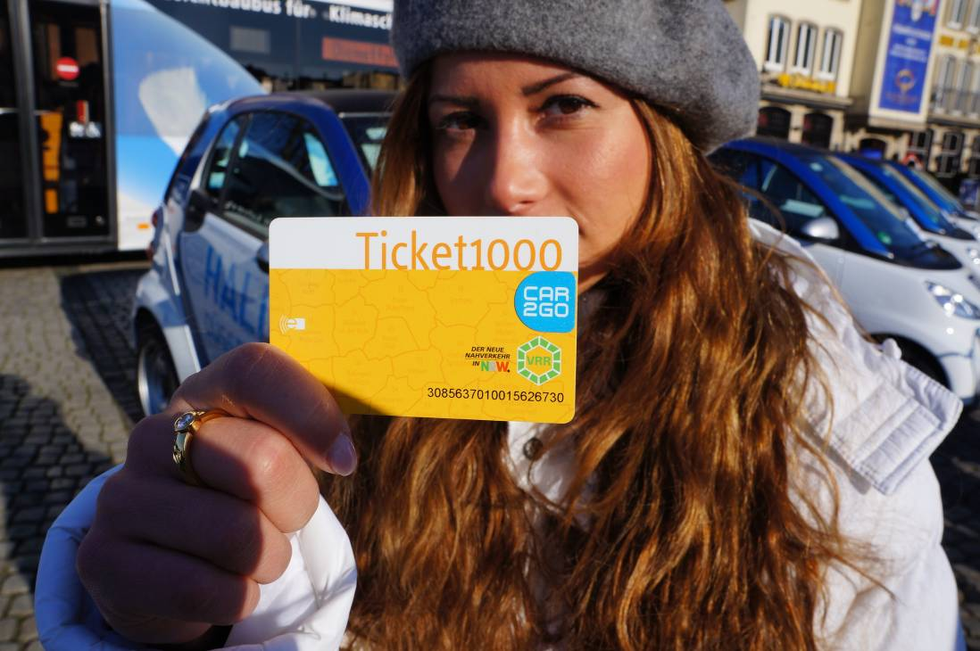
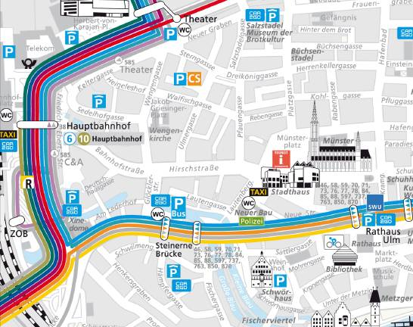

Car2Go compliments public transport
Integrated mobility partnership. Train, bus, bike-sharing and Car2go available in Dusseldorf.
Joint marketing. Incentive to purchase a public transport season ticket with free Car2go minutes included.
Joint ticketing. One card covergin a range of mobility solutions.
Joint platform. View of taxi and Car2Go vehicles available in
the same application.

Slide 7
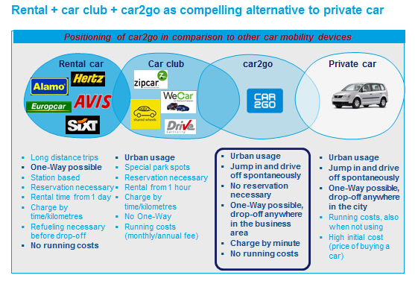
What will be the impact on traditional car clubs?

Slide 8
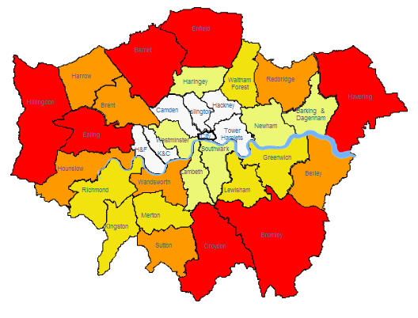
WESTTRANS AREA
1.6 Million People
561,838 cars
500 car2go cars
(0.0003%)
Borough | Cars in borough | Cars per Household
Hillingdon | 122,486 | 1.2
Harrow | 100,326 | 1.2
Ealing | 112,845 | 0.9
Brent | 87,802 | 0.8
Hounslow | 94,042 | 1.1
H&F | 43,843 | 0.5
 | 561,344 | 0.0003% of total vehicle in the WESTTRANS group
Cars per household
heat map

Slide 9
How can we introduce car2go to your borough ?
Next Steps
car2go require 100% access to all parking stock which includes residential, business and all pay and display within controlled parking zones.
car2go will formally submit a formal proposal, service level agreement and a fair parking permit price for each borough.
car2go will consult with the borough team to estimate the amount of vehicles car2go could introduce based on population density and geographical size of the borough.
car2go will liaise directly with residents associations and key stakeholders pre-launch to explain clearly and concisely what benefits car2go will bring to your borough. This action will support all additional marketing activities borough and city wide.
Car2go are seeking to launch all interested boroughs from WESTTRANS in September/October ‘13.

